Slide 1

Maximum Cardinality Matching
Final Presentation
Thomas Meier
Isa Roesch
Conradin Roffler
Samuel Ueltschi

Slide 2
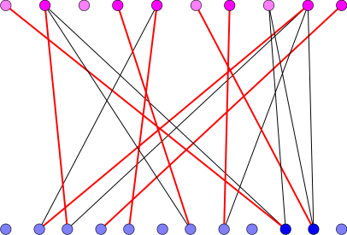
Bipartite Maximum Cardinality Matching
Image source: http://lemon.cs.elte.hu/pub/doc/latest-svn/bipartite_matching.png

Slide 3
Related Work
Azad Ariful, et al. Multithreaded algorithms for maximum matching in bipartite graphs. Parallel & Distributed Processing Symposium (IPDPS), 2012 IEEE 26th International. IEEE, 2012.
Parallel Pothen Fan (PPF)
Azad Ariful, Aydin Buluç, and Alex Pothen. A parallel tree grafting algorithm for maximum cardinality matching in bipartite graphs. Parallel and Distributed Processing Symposium (IPDPS), 2015 IEEE International. IEEE, 2015.
Tree Grafting Algorithm (TG)
Claim: PPF not suitable for many thin cores

Slide 4
Contribution
Implemented PF and PPF to reproduce results of paper
Analysed performance of PPF on Xeon Phi
Basic parallel tree grafting implementation

Slide 5
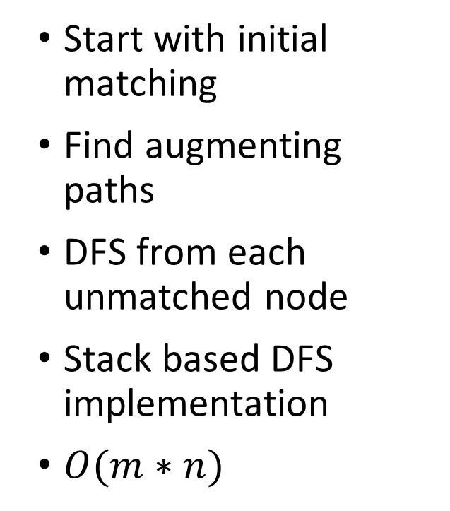
Pothen-Fan
unmatched nodes
Start with initial matching
Find augmenting paths
DFS from each unmatched node
Stack based DFS implementation
$O(m∗n)$

Slide 6

Parallel Pothen-Fan
unmatched nodes
Find augmenting paths in parallel
Paths must be vertex disjoint
DFS locks each visited vertex
Test and Test and Set
if (!visited[v] && !TAS(&visited[v])) {
...
}

Slide 7
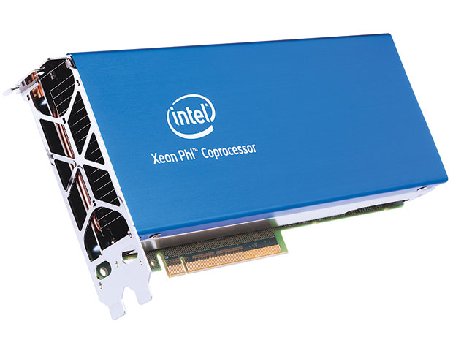
Experimental Setup
Xeon Phi (5110P)
OpenMP
Boost Graph Library
C++ (-O3)
Correctness verified with reference solution
Test Data
 | |V| | |E| | Density [0,1]
coPaperDBLP | 1’080’872 | 15’245’732 | 1.3e-5
Wikipedia | 7’030’396 | 45’030’392 | 9.1e-7
Amazon0312 | 801’454 | 3’200’440 | 5.0e-6
Image source: http://hips.seas.harvard.edu/files/xeon-phi.jpg

Slide 8
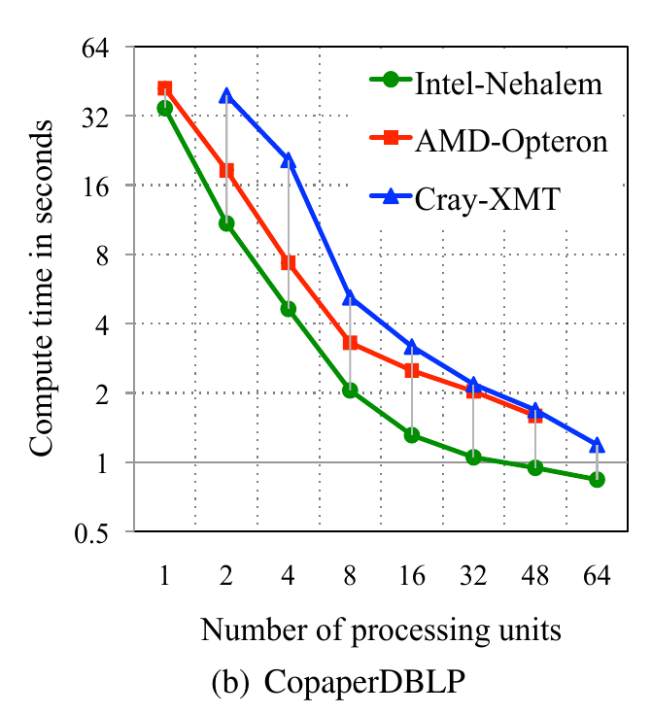
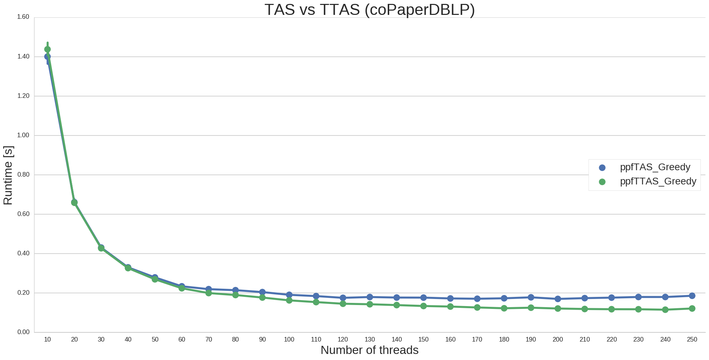
Parallel Pothen-Fan with TTAS

Slide 9
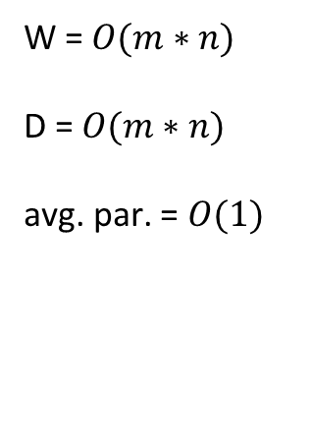
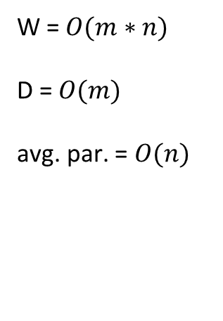
Parallel Pothen-Fan - PRAM
Best Case
Worst Case
W = $O(m∗n)$
D = $O(m)$
avg. par. = $O(n)$
W = $O(m∗n)$
D = $O(m∗n)$
avg. par. = $O(1)$
...
...
...
...
|V| = n
|E| = m
...

Slide 10
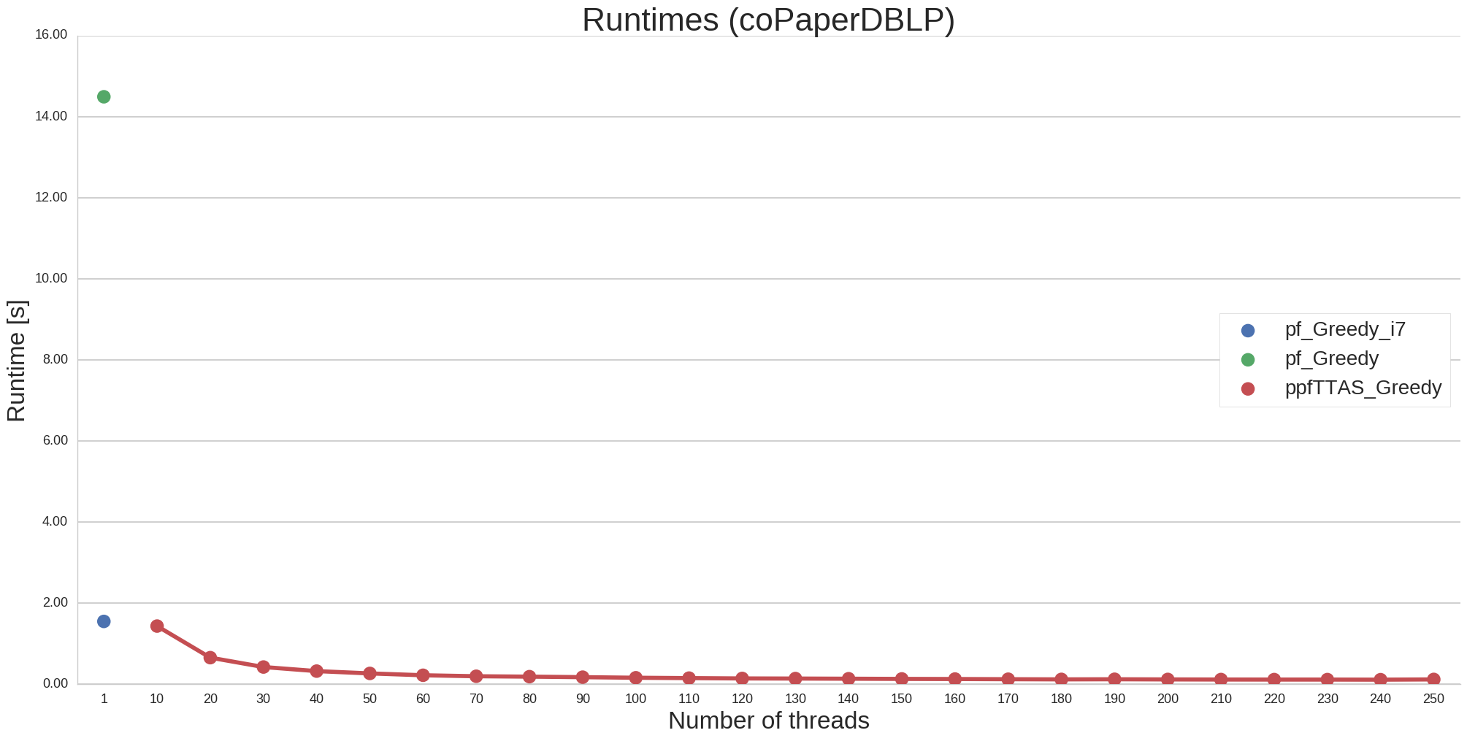
Parallel Pothen-Fan Performance
baseline for speedup

Slide 11
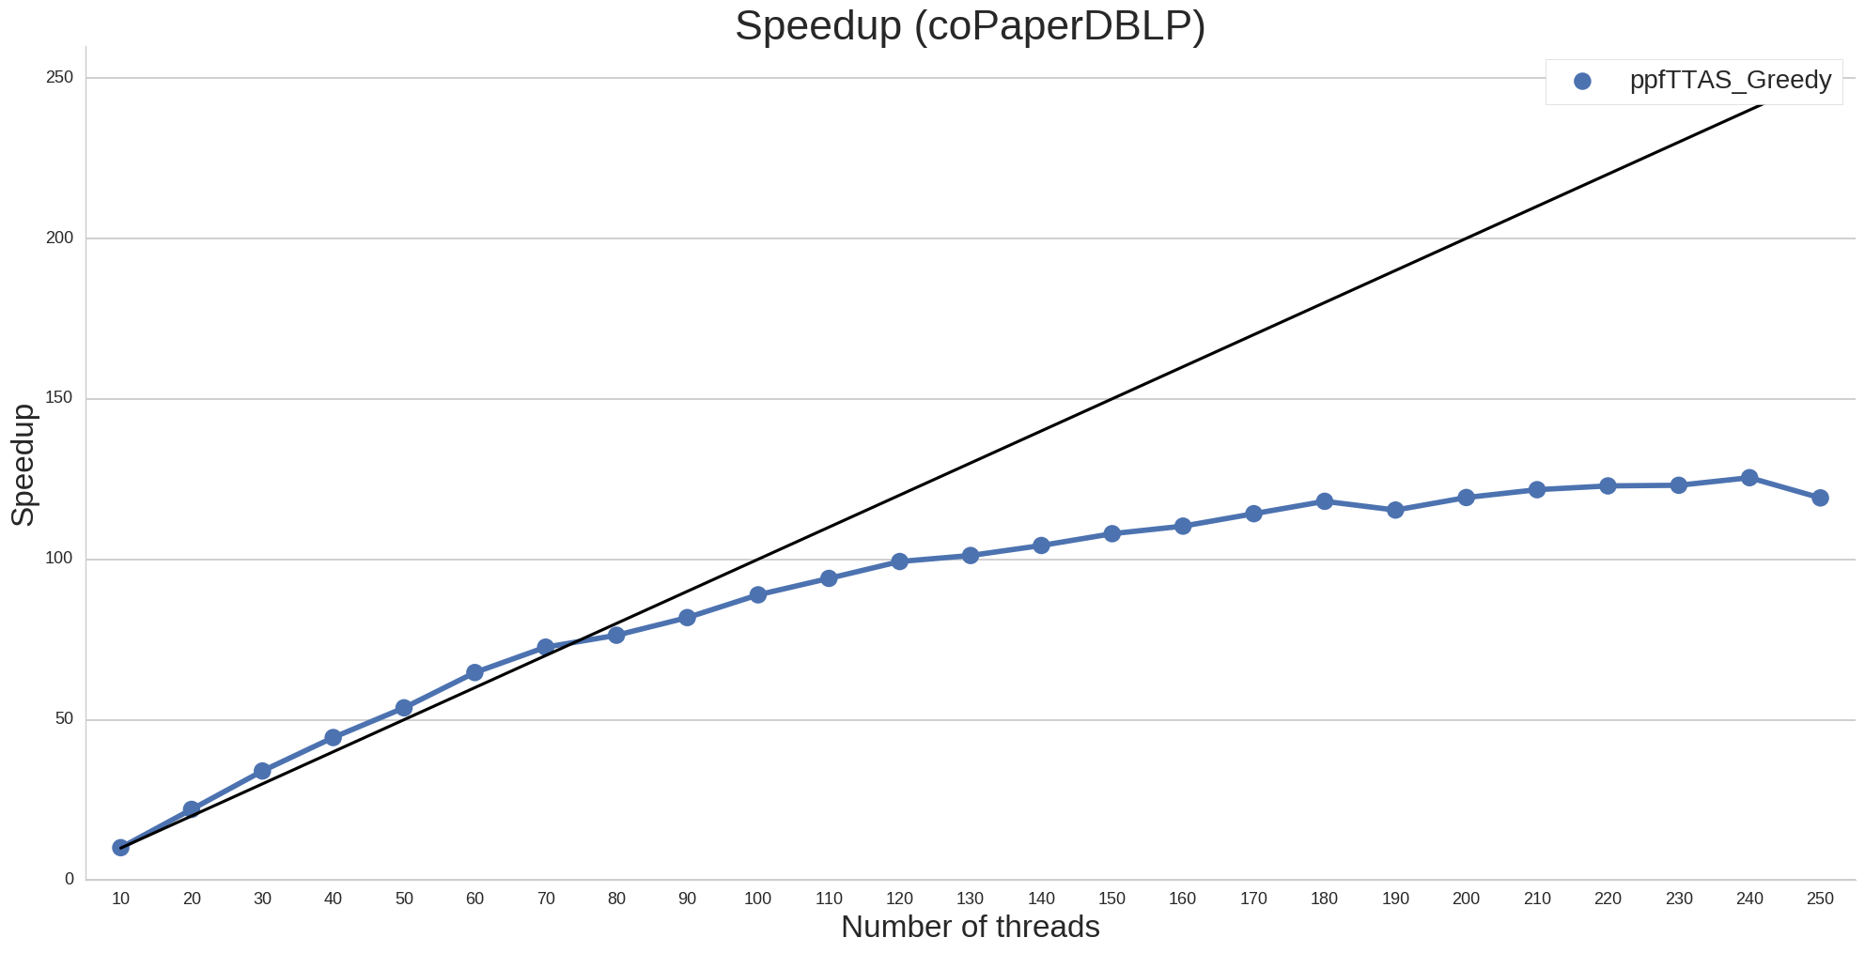
Parallel Pothen-Fan Performance

Slide 12
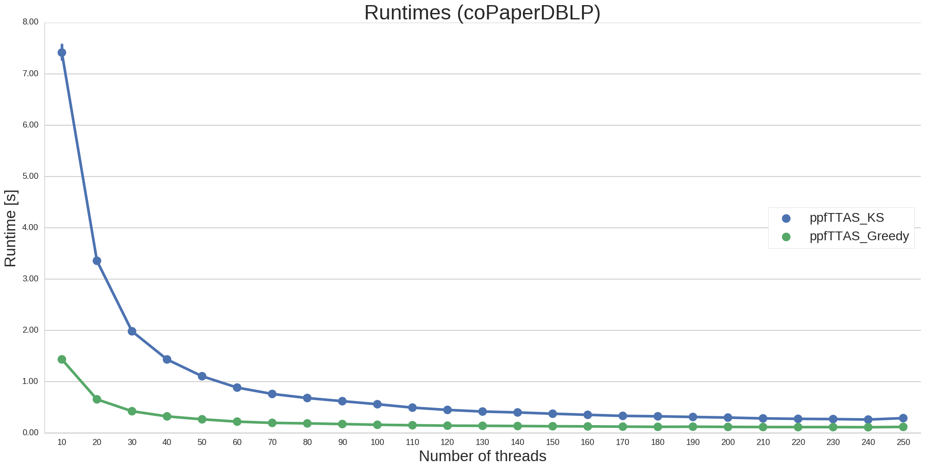
Influence of Initial Matching
Initial Matching:
KS: 97%
Greedy: 99%

Slide 13
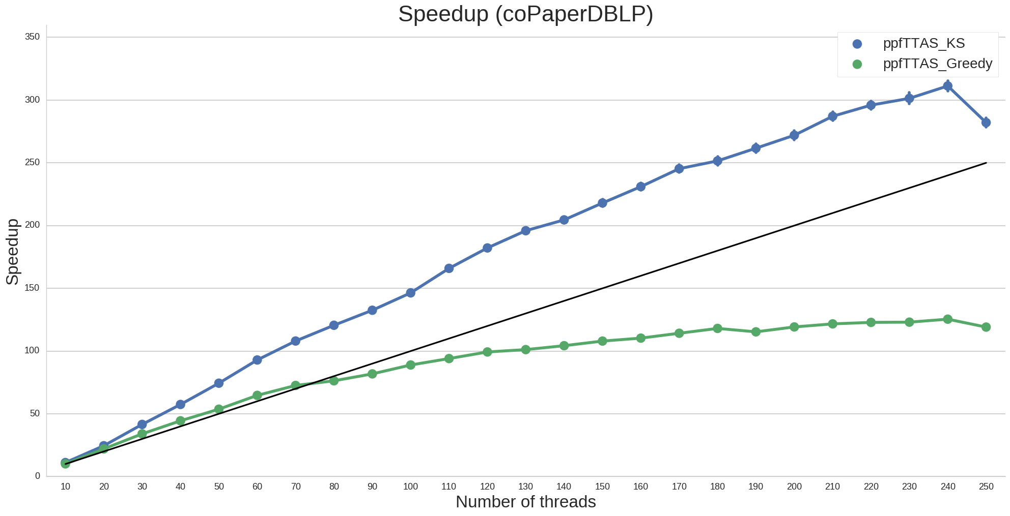
Influence of Initial Matching
Initial Matching:
KS: 97%
Greedy: 99%

Slide 14
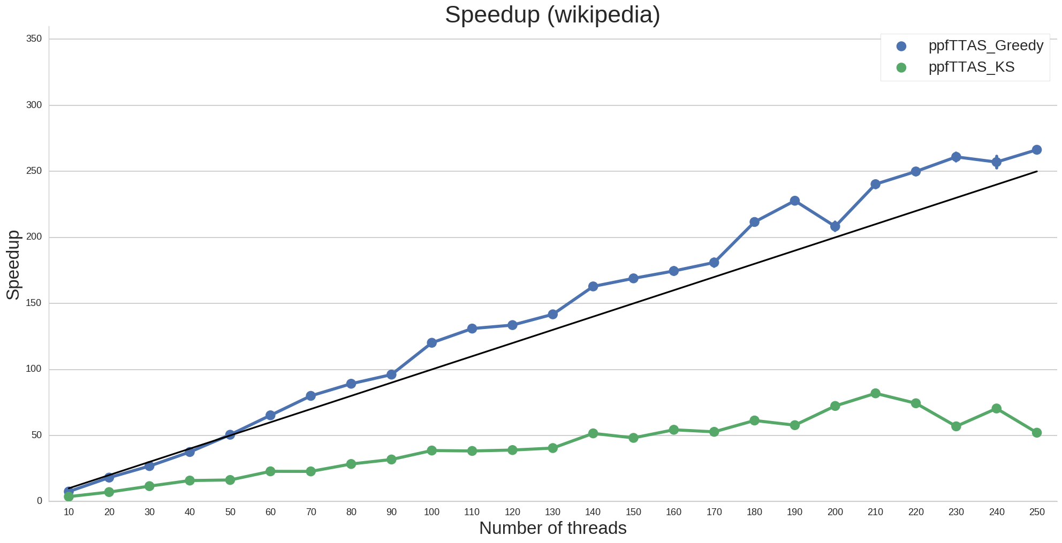
Influence of Initial Matching
Initial Matching:
KS: 99%
Greedy: 91%

Slide 15
Conclusion
Implemented PF and PPF to reproduce results of paper
minimized working set and synchronization overhead
Bad initial matchings benefit from parallelism
Despite the papers claim[1]: PPF scales well on Xeon Phi
Could not reproduce results for Tree Grafting
[1] Azad et al: A parallel tree grafting algorithm for maximum cardinality matching in bipartite graphs.

